Slide 1

MICROPROCESSOR AND COMPUTER ARCHITECTURE LABORATORY
4TH Semester(UE19CS256)
INTRODUCTION CLASS1-ARMSIM
Monday, January 18, 2021
Prof Deepti C
Computer Science and Engineering

Slide 2

Microprocessor & Computer Architecture Laboratory
Course Information
WEEK 1 | Write an ALP using ARM instruction set to add and subtract two 32 bit numbers .Both numbers are in registers. Write an ALP to demonstrate logical operations. All operands are in registers. Write an ALP to add 5 numbers where values are present in registers. Write an ALP using ARM instruction set to check if a number stored in a register is even or odd.

Slide 3
Microprocessor & Computer Architecture Laboratory
WEEK 1 | 1. Write an ALP using ARM instruction set to add and subtract two 32 bit numbers .Both numbers are in registers.
Algorithm
For addition
1.The first number to be stored in R0
2. The first number to be stored in R1
3.Add both the numbers, the result is stored in r2
For Subtraction
1.The first number to be stored in R0
2. The first number to be stored in R1
3.Subtract both the numbers, the result is stored in r2
Example R0=10=Hex 0A R1=20=Hex 14 After Addition R2=30=Hex 1E After Subtraction R2 = 10 = Hex 0A
R0 | R1 | Arithmetic Operation | Result
0x0A | 0x14 | ADD | R0 =0x1E
0x0A | 0x14 | SUBTRACT | R0=0x0A
Instructions to be used
MOV,ADD,SUB

Slide 4
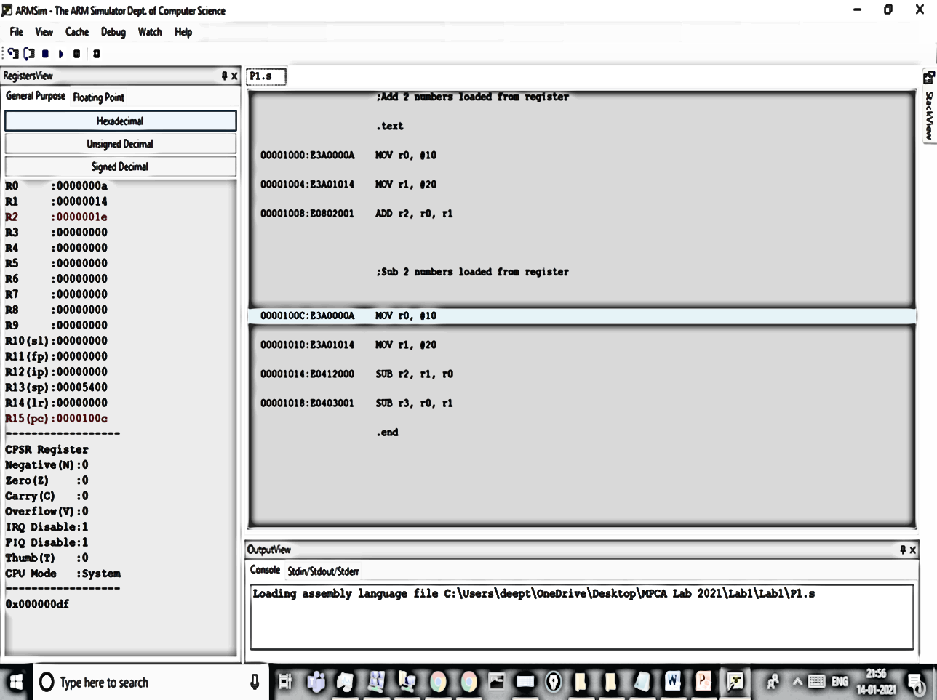

Slide 5
Microprocessor & Computer Architecture Laboratory
WEEK 1 | 2. Write an ALP to demonstrate logical operations. All operands are in registers.
R0 | R1 | Logical Operation | Instruction | Result
0x05 | 0x06 | AND | AND | R0 =0x04
0x05 | 0x06 | OR | ORR | R0 =0x07
0x05 | 0x06 | EX-OR | EOR | R0 =0x03
0x05 |  | NOT | MVN | R0 =0xfffffffa
Algorithm
1.The first number to be stored in R0
2. The second number to be stored in R1
3.AND operation between both the numbers, the result is stored in R2
4. OR operation between both the numbers, the result is stored in R3
5. EX-OR operation between both the numbers, the result is stored in R4
6. NOT operation on number in R0, the result is stored in R5

Slide 6
Microprocessor & Computer Architecture Laboratory
WEEK 1 | 3.Write an ALP to add 5 numbers where values are present in registers.
R0 |  | 0x05
R1 |  | 0x06
R2 |  | 0x07
R3 |  | 0x06
R4 |  | 0x15
R5 | R0+R1 | 0x0b
R6 | R5+R2 | 0x12
R7 | R6+R3 | 0x18
R8 | R7+R4 | 0x27
Algorithm
1.The first number to be stored in R0
2. The second number to be stored in R1
3. The second number to be stored in R2
4.The second number to be stored in R3
5.The second number to be stored in R4
6.Add the first two numbers, the result is stored in r5
7.Result in R5 is added with the third number, the result is stored in R6
8. Result in R6 is added with the fourth number, the result is stored in R7
9. Result in R7 is added with the fifth number, the result is stored in R8
Instructions to be used MOV,ADD

Slide 7
Microprocessor & Computer Architecture Laboratory
WEEK 1 | 4.Write an ALP using ARM instruction set to check if a number stored in a register is even or odd. If even, store 00 in R0, else store FF in R0
Algorithm
1.The number is to be stored in R1
2. AND operation between the given number and constant 1,result of AND operation is stored in R2
(Use instruction ANDS to ensure flags are updated)
4. If the LSB bit of R2 after the AND operation is zero,it indicates even number
If true,Branch to label Location 1,copy 00 into R0 register
Else
5. If the LSB bit of R2 after the AND operation is one,it indicates odd number
If true,Branch to label Location 2,copy FF into R0 register
CASE 1 | R1 |  | 0x06
 | R2 | After AND operation | 0x00
 | R0 | (EVEN) | 0x00
CASE 2 | R1 |  | 0x05
 | R2 | After AND operation | 0x01
 | R0 | (ODD) | 0xFF

Slide 8
THANK YOU
Deepti C
Department of Computer Science and Engineering
deeptic@pes.edu

